Slide 1
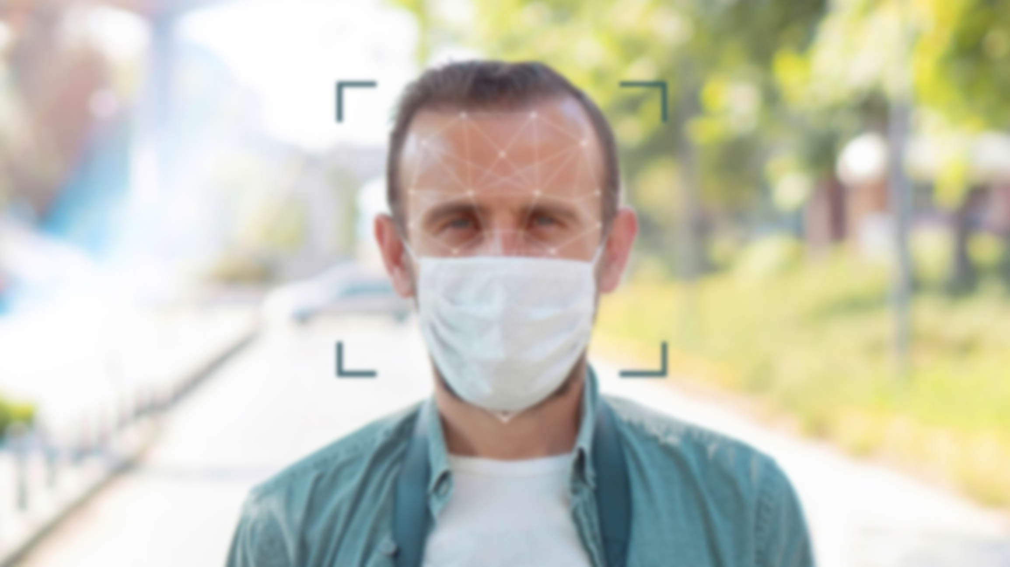
Face Mask Detection Using python
Akshat Singhal
2017453
B.Tech CST
Under the mentorship of
Ms. Meenakshi Maindola

Slide 2
Introduction and Problem Statement
Face Mask Detection, What is it? And why do we need it?
The rising of corona virus or covid 19 shows the importance of masks in our life, which helps in preventing and ultimately defeating the corona virus.
But sometimes people get careless and forget to put on their masks and go to public gathering. Now one way to stop that is to hire security to ensure proper mask on each person’s face, but as simple as it may seems it is a hectic task as we need no monitor each and every person all the time.
So to solve this problem here comes the power of machine learning to saves the day. I am building a face mask detection using custom vision and deep learning concepts which will help in detecting mask on people faces using camera.

Slide 3
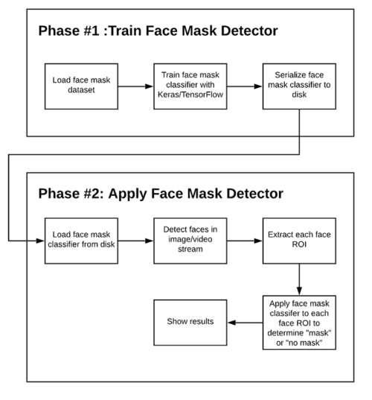
Methodology

Slide 4

Phase 1
Load face mask dataset:
Dataset contains 868 images of people with mask and 868 images of people with mask.
Now to gather this dataset I build artificial dataset for people with masks using facial landmarks on the faces and then appending a face mask artificially.
Training and fine tuning the model:
Loading image data: First we will load the image dataset into the memory including the original photos and artificial photos I obtained for faces with mask.
Preprocess image: It resizes the image into 224X224 pixels, and convert it into array format
Mobilenet v2 architecture: Load the predefined mobile net architecture and fine tune it.
Save model to disk: After the model is fully trained, save it tothe disk so that it can be loaded into memory at the time of mask detection

Slide 5
Phase 2
Load the model we just trained: load the model we just trained into the memory so that we can classify face with mask or no mask
Detect face in image or video stream: Detect all the faces available in the video stream using any method whether it is a custom model, Har cascade or something else, then feed this faces location to the model and it will give result as output that whether this face has mask or not.

Slide 6
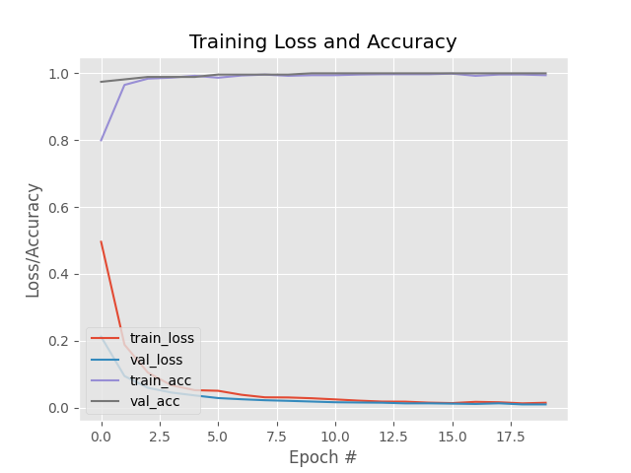
Results and discussion
This is the loss and accuracy graph of the model trained described in the methodology

Slide 7
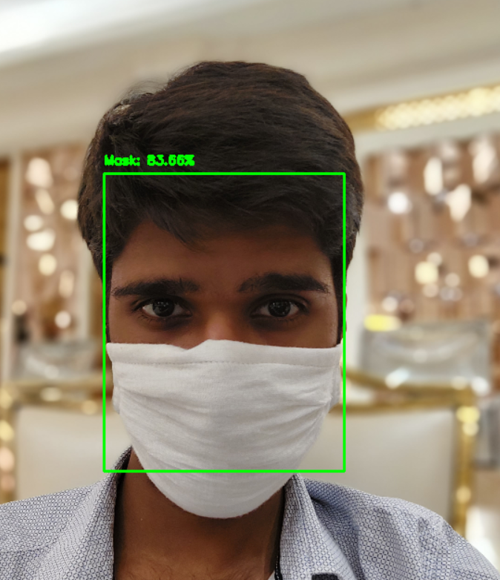
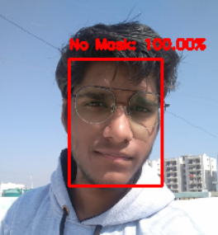
Detecting the mask on my face with the confidence score
Detecting no mask on my face with 100% confidence

Slide 8
Conclusion
This project has helped me learn many aspects of machine learning, I also learned how to fine tune the models and save models so that they can be used in other programs.
This project has the potential to help many people if implemented everywhere it will reduce the spread of covid 19 to an exponential rate.

Slide 9
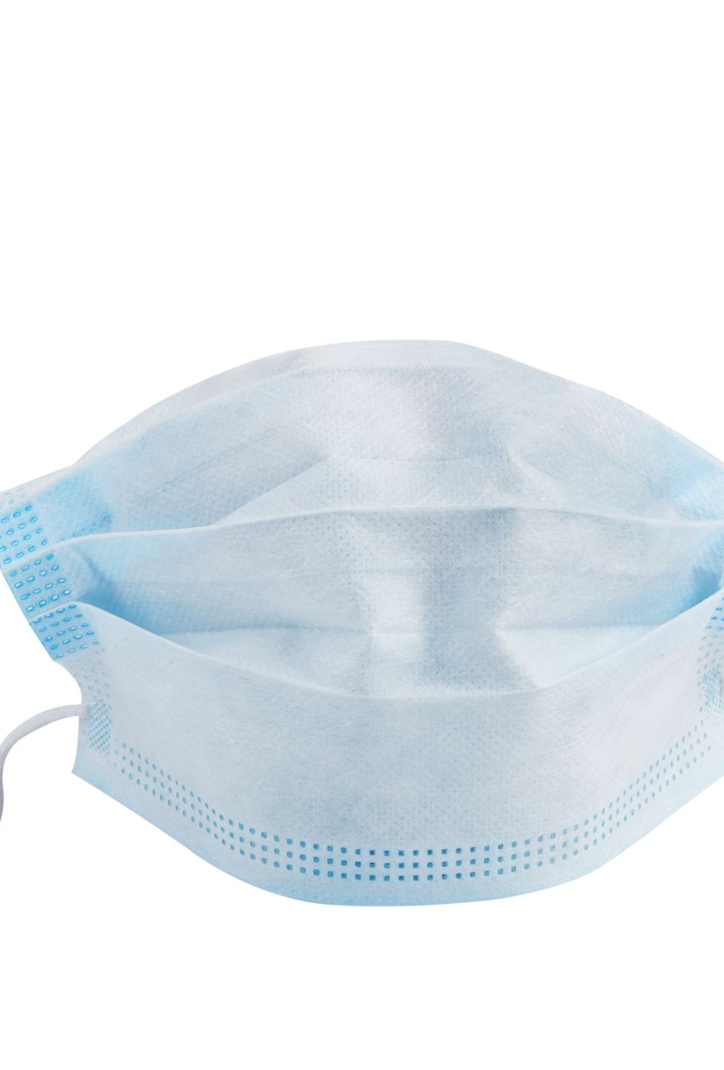
Future Work
In this project, there is one limitation that for detecting a mask, a face must be detected first. So, to remove this limitation I will try to make an object detection model in future so that it will detect the mask in the given input rather than mask on face it will remove this limitation and will be able to detect the masks even if face is not detected.

Slide 10

Thank You

